Slide 1
Inbound and Outbound User Journey Flow for Delivery Vertical App

Slide 2
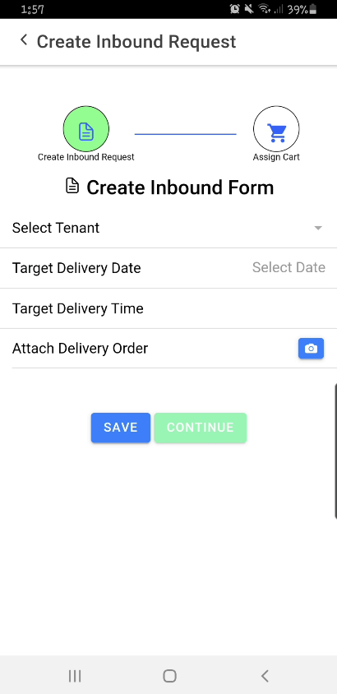
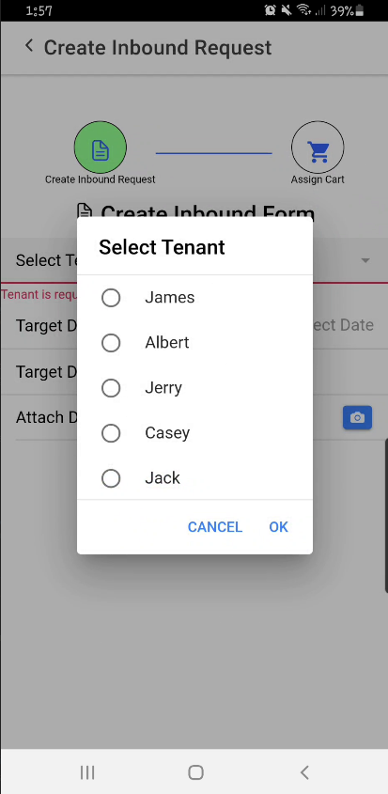
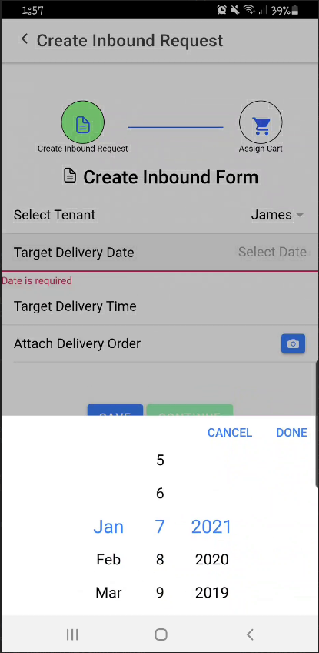
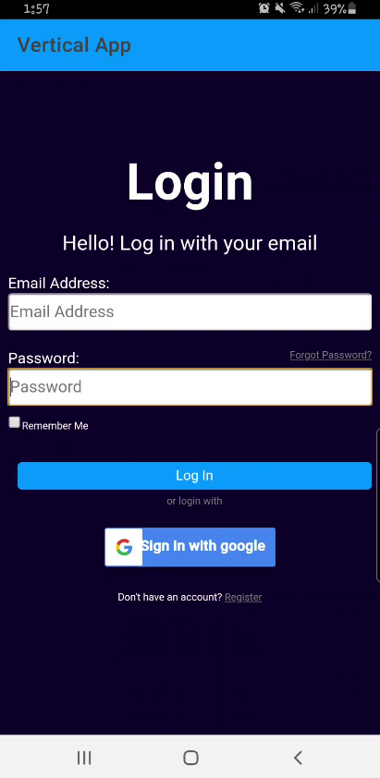
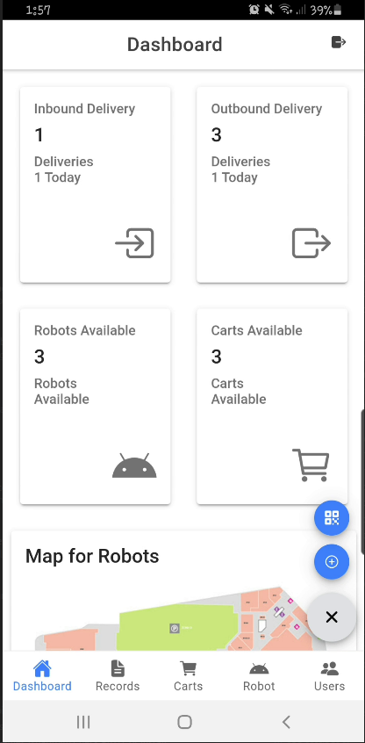
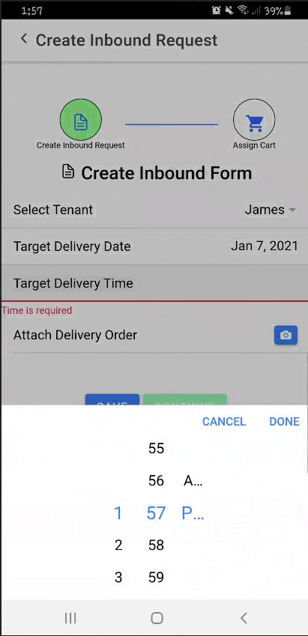
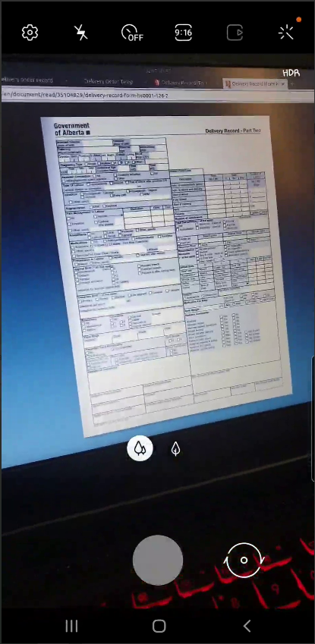
Inbound Delivery
Depot Admin will login to the Vertical App
Depot Admin Create Inbound Delivery Request

Slide 3
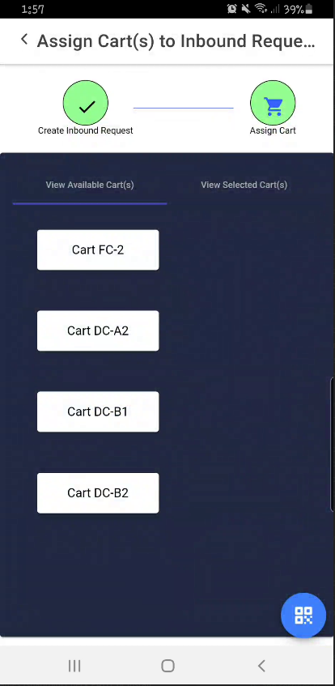
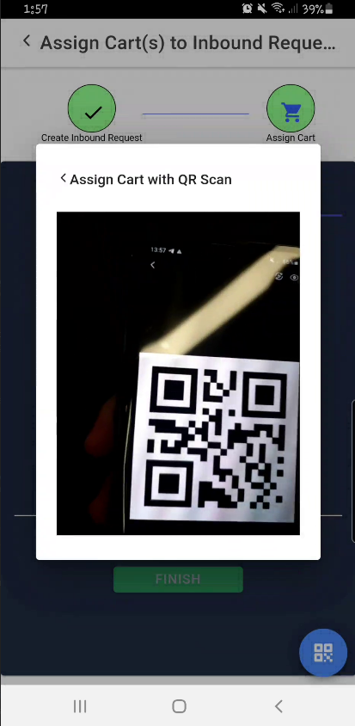
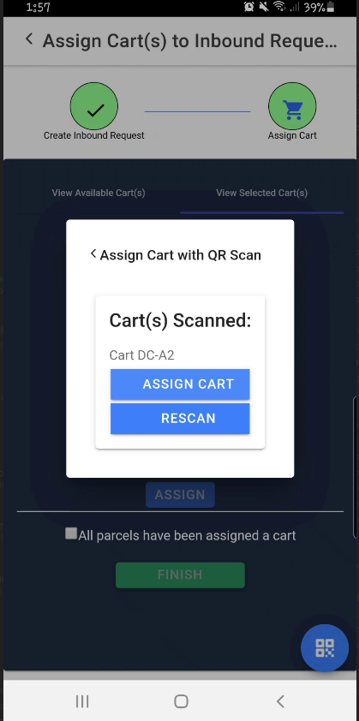
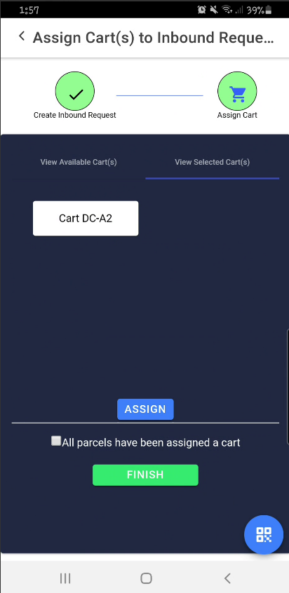
Inbound Delivery
Depot Admin assigns a available cart to delivery request
Vertical application sends a job request for the delivery robot
Delivery Robot comes and pickup cart for delivery to building tenant

Slide 4
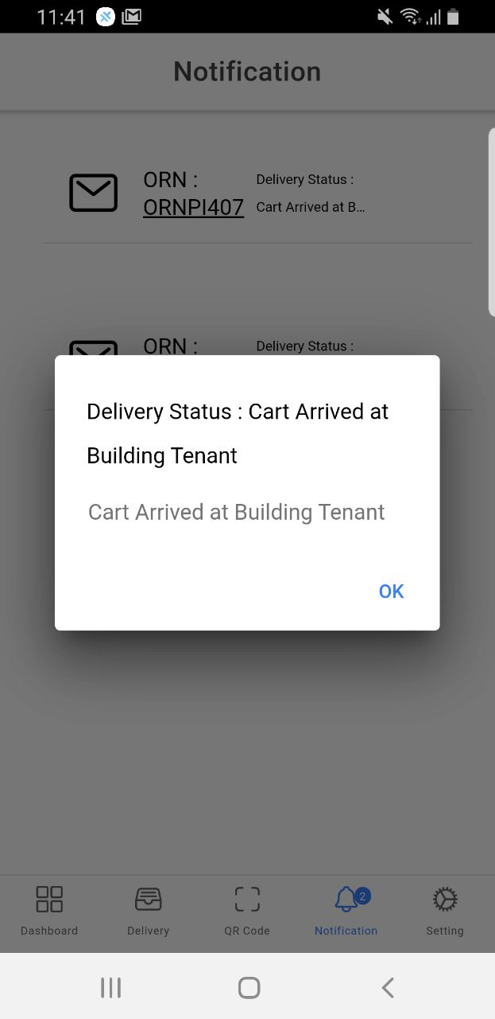
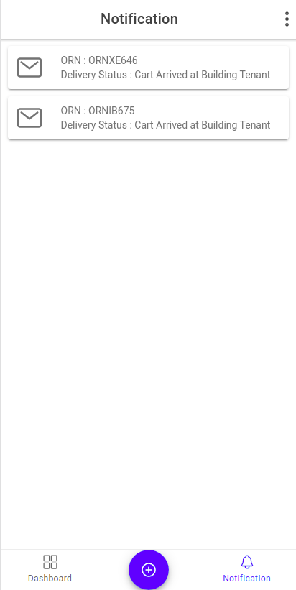
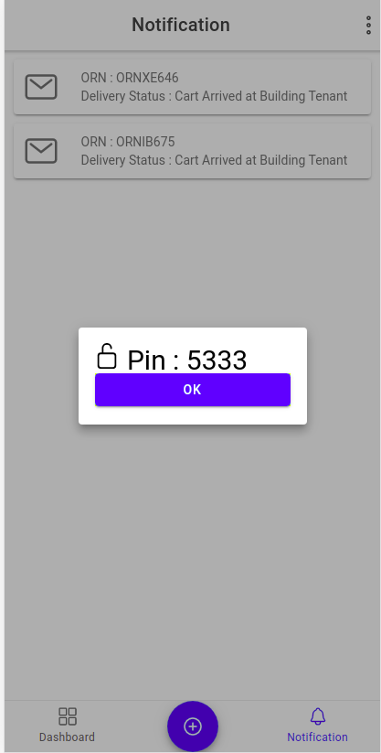
Inbound Delivery
Cart will arrive at building tenant.
Building Tenant will receive notification when the cart have arrived
Building Tenant will unlock the cart with the pin number that it receives and retrieve their parcel
Inbound Delivery is finished. Robot and Cart will move back to the Depot Admin's Location
Robot and Cart will become available and the inbound flow will be completed

Slide 5
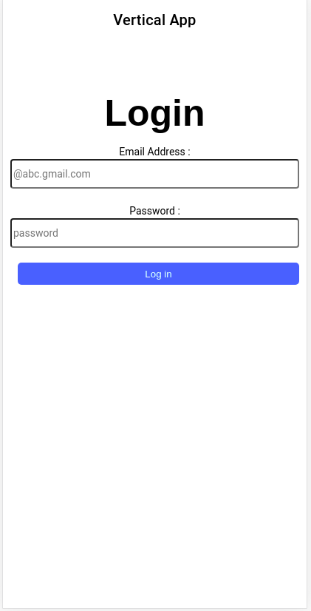
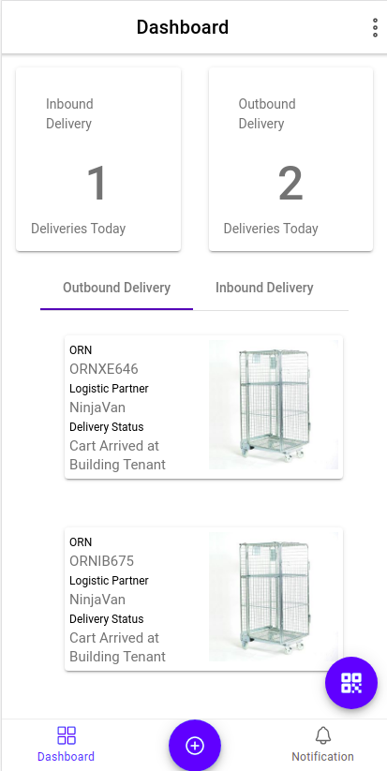
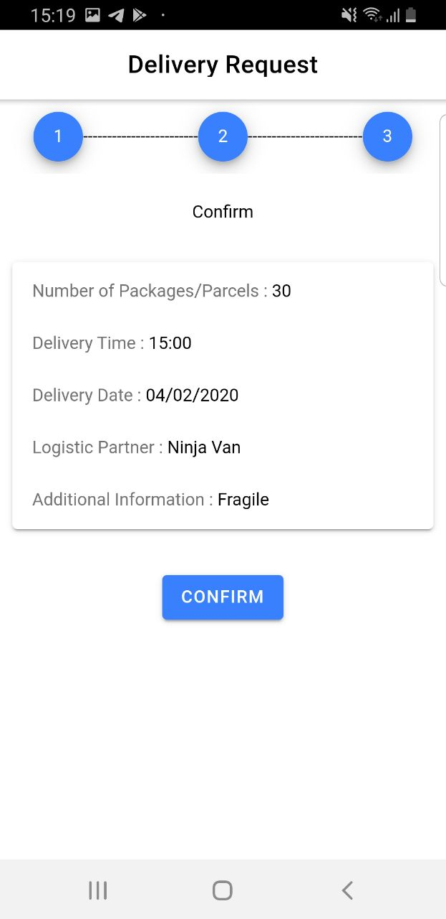
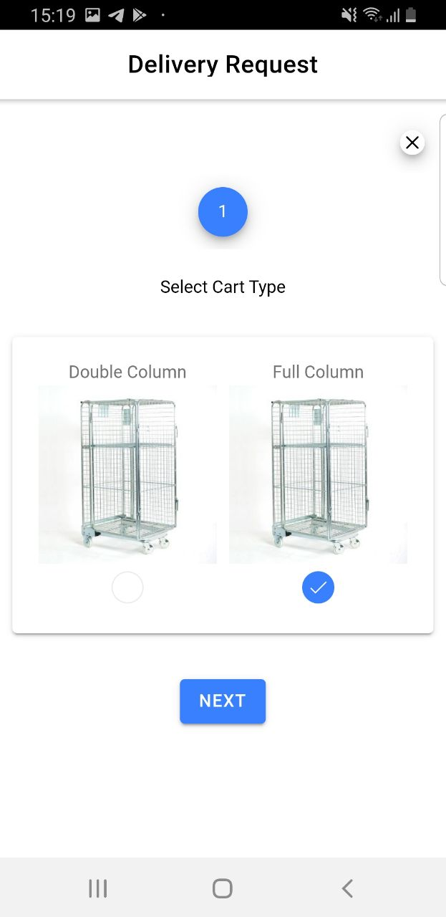
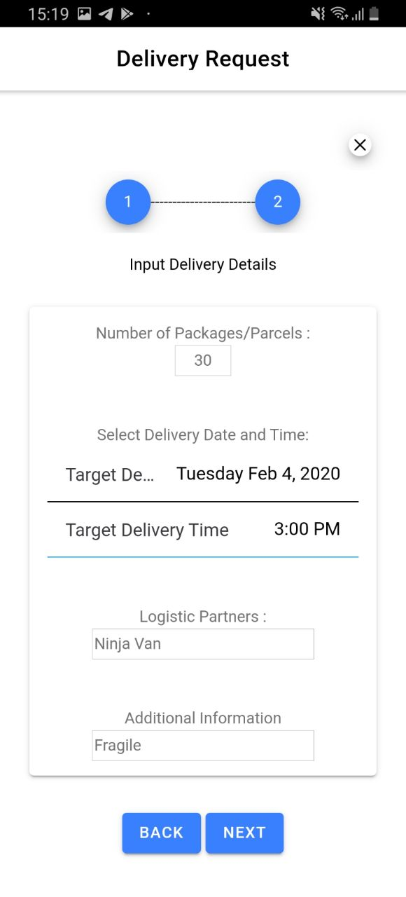
Outbound Delivery
Building Tenant Login into the vertical application
Building Tenant create Delivery Request for an Outbound Delivery

Slide 6
Outbound Delivery
Delivery Robot will pick up a available cart for delivery
Vertical Application will send Robot Manager a job request for a robot to move to Depot Admin location
Delivery Robot will pick up a cart from the location of the Depot Admin and move to Building Tenant with a empty cart
Cart And Robot arrives at Building Tenant where Building Tenant location
Building Tenant will be notified that a available cart has arrived and proceeds to load the cart with the parcels for delivery

Slide 7
Outbound Delivery
Vertical Application will send Robot Manager a job request for a robot to move to Depot Admin location
Depot Admin Unlock and Unload the parcels when robot and cart reached Depot Admin Location
Robots and Carts becomes available and the Outbound Delivery is completed
Outbound User Journey Ended

